Slide 1
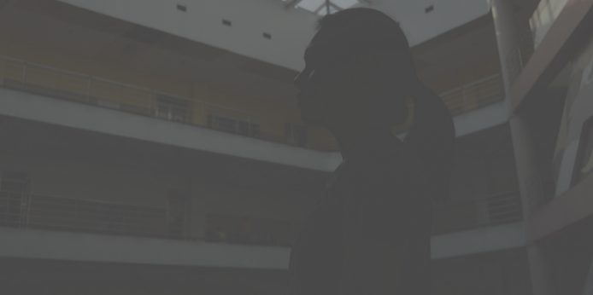
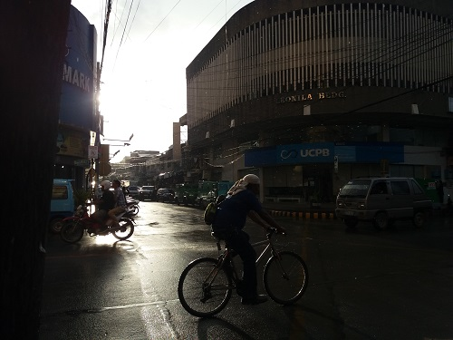
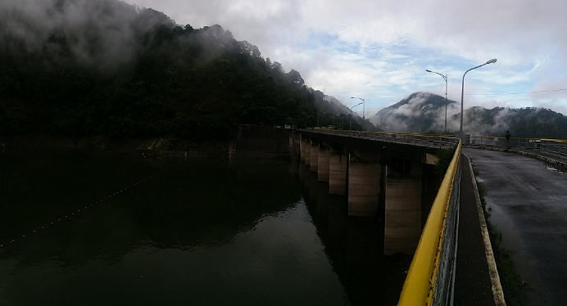
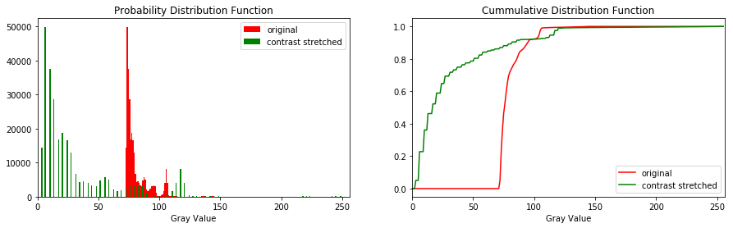
Rene L. Principe Jr.
2015-04622
Dr. Maricor Soriano
Applied Physics 186
Activity 5– Enhancement by Histogram Manipulation
C.
A.
B.
Figure 1. (A) Low-contrast indoor image. (B) Ambuklao Dam in Benguet. (C) High-contrast-downtown outdoor scene.
Image enhancement can reveal extra information not necessarily obvious to the naked eye nor on the image taken. In this short report, we exploit the histogram characteristics of an image to possibly reveal more visual information.
To start, I chose 3 images to be manipulated shown in Figure 1. These RGB images were first converted to Gray images since a single channel histogram manipulation would not be a very tedious task. Fig. 1A is a portrait shot which was intentionally edited to be a low-contrast and low-brightness image to see the drastic effects. This is because the first manipulation that I employed is the contrast stretching method. Statistically, a low contrast image has a low variation of gray values in its histogram. Shown in Fig, 2 is the histogram behavior of a low contrast image (red). Upon employing the algorithm, which makes bright pixels brighter and dark pixels darker accordingly, the histogram is literally stretched across wider range of gray values (green).
Figure 2. Statistical characteristics (Histogram) of a low-contrast and contrast stretched image.

Slide 2
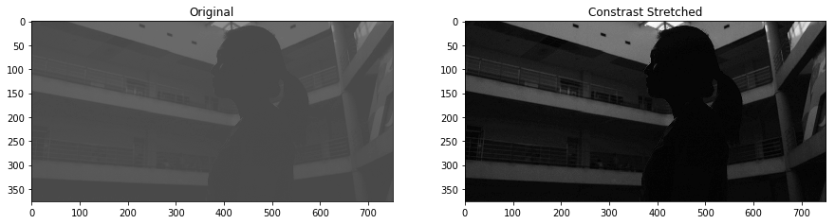
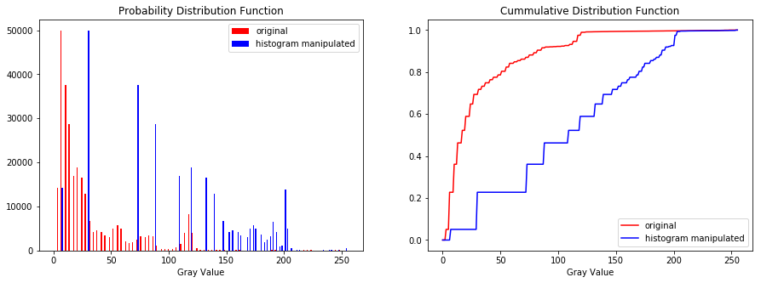
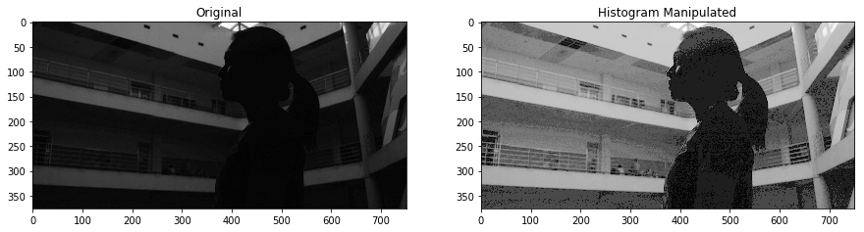
Figure 3, High-contrast image was attained by using the contrast stretching algorithm.
The contrast stretching method was also applied to the other images, however, there are no significant change in the visual appearance because the images are of high contrast to begin with already.
Next, histogram back projection was applied to image with a desired linear CDF. Statistically, the plots on Fig. 3 shows how histogram back projection affects the PDF and CDF of an image. The gray values were appropriated in the PDF and the CDF now mimics a linear response. Visual results in Fig. 4 show an obvious difference in the appearance of the original and back-projected image. Details of the railings, walls, ceilings, etc. in the background are now more “perceivable”. In fact, I never knew there were students on the upper floor in the background until the image was manipulated. The edges of the objects now has more crisp to it.
Figure 3. Statistical characteristics of a low-contrast and histogram back-projected image..
Figure 4. Histogram back projection manipulation reveals more details in the dark areas of the original image.

Slide 3
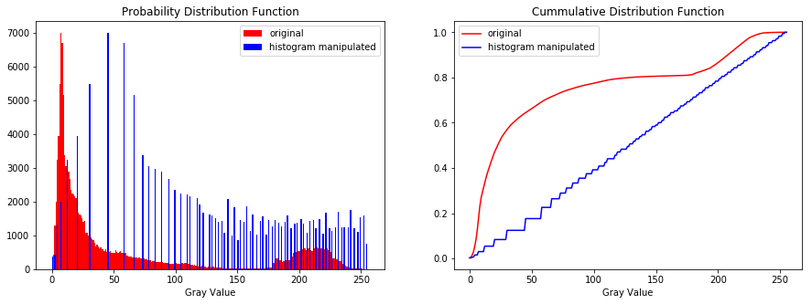
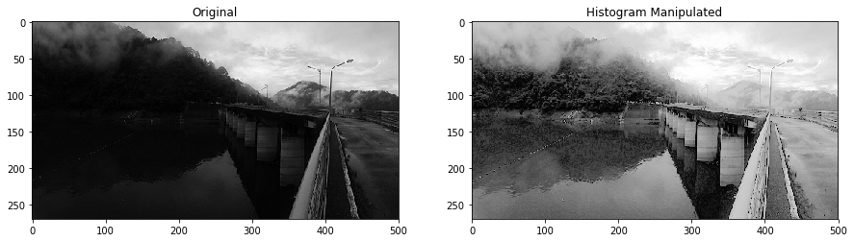
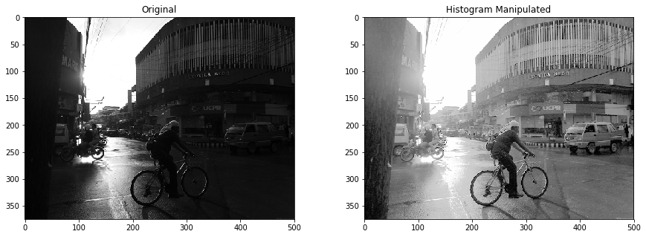
Figure 5. Statistical characteristics of a dim outdoor scenery and histogram back-projected image..
Figure 6. Histogram back projection manipulation reveals more details in the dark areas of the initially dim outdoor scenery. The land and water interface are now much more visible as well as the rope with floating balls.
The next image utilized was an image taken at the Ambuklao Dam in Benguet. Landscape shots like these are often imbalanced. The brightness of the sky overpowers the scenery which is why most portions are dark. Although the image has a high contrast in nature (contrast stretching has no significant effect), I want to find out what more information can I get on those dark areas when I employ histogram back-projection. In Fig.5 are the statistical effects of back-projecting on a CDF linear response. Shown in Fig. 6 is the result of the algorithm and indeed, more details were revealed. The outdoor downtown scenery was also captured on a raining sunset which has an intense contrast. Shown in Fig. 7 is its CDF mapping to a linear response and the result revealed more details about the foreground and background. The image was also visually pleasing to look at.
Figure 7. Resulting image by manipulation using histogram back projection. The high contrast scenery turned out to have hidden details.

Slide 4
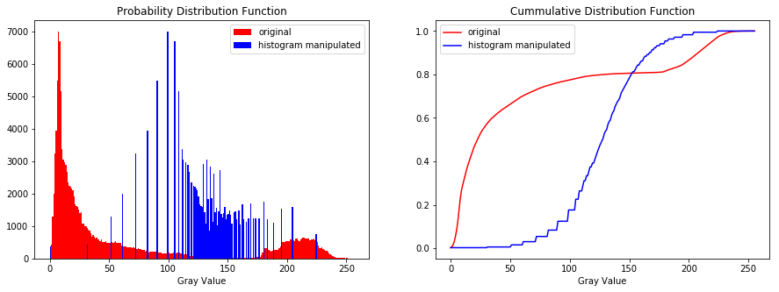
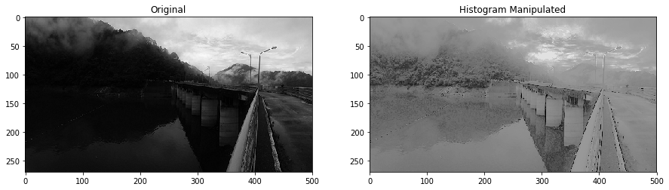
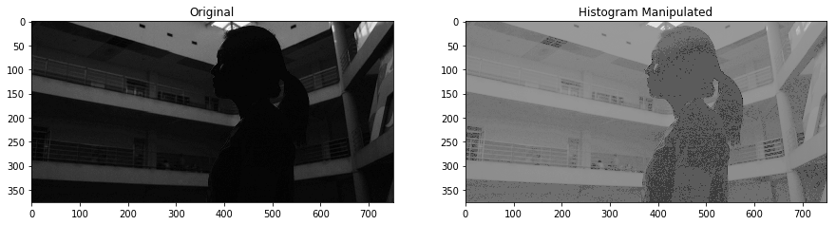
Figure 8. Statistical properties of the resulting image manipulated using Sigmoid CDF back-projection
Figure 9. The image produced projected onto a sigmoid CDF turned out to be a low-contrast image.
Exploring further, what if the desired CDF is non-linear? For example, I tried the histogram back-projection on the images with the desired sigmoid function as a CDF. The resulting CDF of the manipulated image mimicked the CDF of a sigmoid function as shown in Fig. 8. Visually, the image returned in as seen in Fig. 9 has a low contrast. This is because the bulk of change in gray values as per the sigmoid CDF is concentrated on the gray pixels in the center. This desired CDF could be used for other scenes but in this report, the linear CDF back-projection returned visually pleasing image with just with the right amount of information.
Figure 10. Another result of back-projecting onto a sigmoid CDF. There isn’t enough contrast to discriminate objects in the foreground and the background.
Self Evaluation:
In this activity, I’d give myself a 9.5. I really enjoyed it a lot and I actually managed to implement my code successfully during class hours. I’m a big fan of image manipulation especially in Adobe Lightroom where I fancy changing the image curves and now I know the physics behind all of those manipulations (bonus: I did these curve manipulation on my own). I should’ve explored more about the back-projecting on nonlinear CDFs but I got busy with my other endeavors Yay to a new skillset. <3

